Slide 1


e-Commerce Store
Presented By: Godstime Obasi

Slide 2
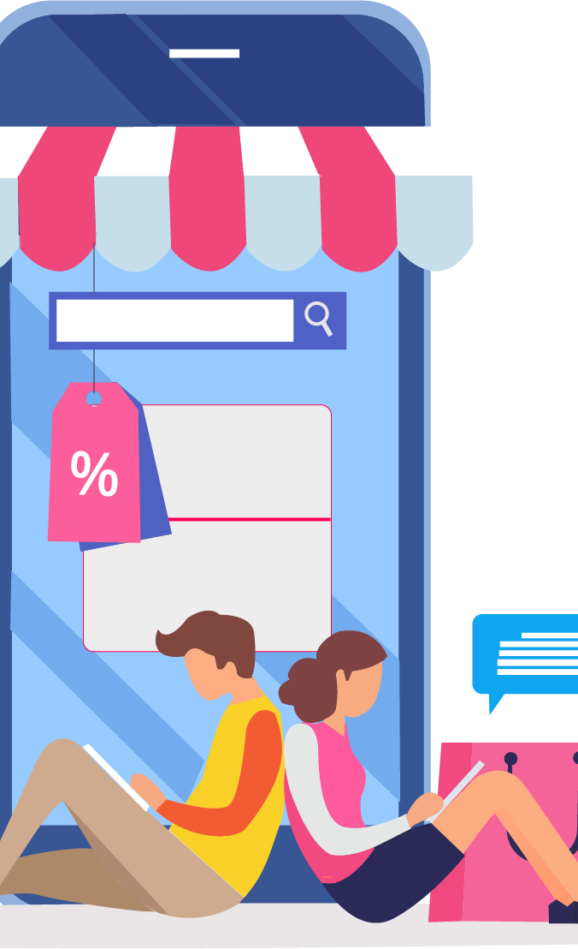
WHO WE ARE?
ABOUT US
Betterbuy.com is an e-commerce start-up company positioning itself to become the market leader in offering online merchants and consumers a uniform and trouble-free way to return merchandise purchased online. The company offers a business-to-business solution to online merchants of physical products. The company utilizes a consolidation approach in handling all product returns that allows online merchants to instantly save bad sales, restore customer satisfaction and stimulate repeat sales, while offering consumers ease of search with the camera AI we are implementing and a convenient, centralized online location to claim returns.

Slide 3
OUR SERVICES
Home Delivery
24/7 Support
e-Commerce Store
Scheduled Delivery
Capture and Buy

Slide 4

OUR FEATURES
Betterbuy.com's services streamline the entire return process for retailers. They allow retailers to outsource a large part of their business, allowing the retailer to concentrate on their core competencies and not get distracted with activities that add little value.
FREE SHIPPING & RETURN
ONLINE SUPPORT 24/7
MONEY BACK GUARANTEE
Free shipping on all orders over $100.
100% money back guarantee
Our support team are ready to answer your complaint 24/7

Slide 5
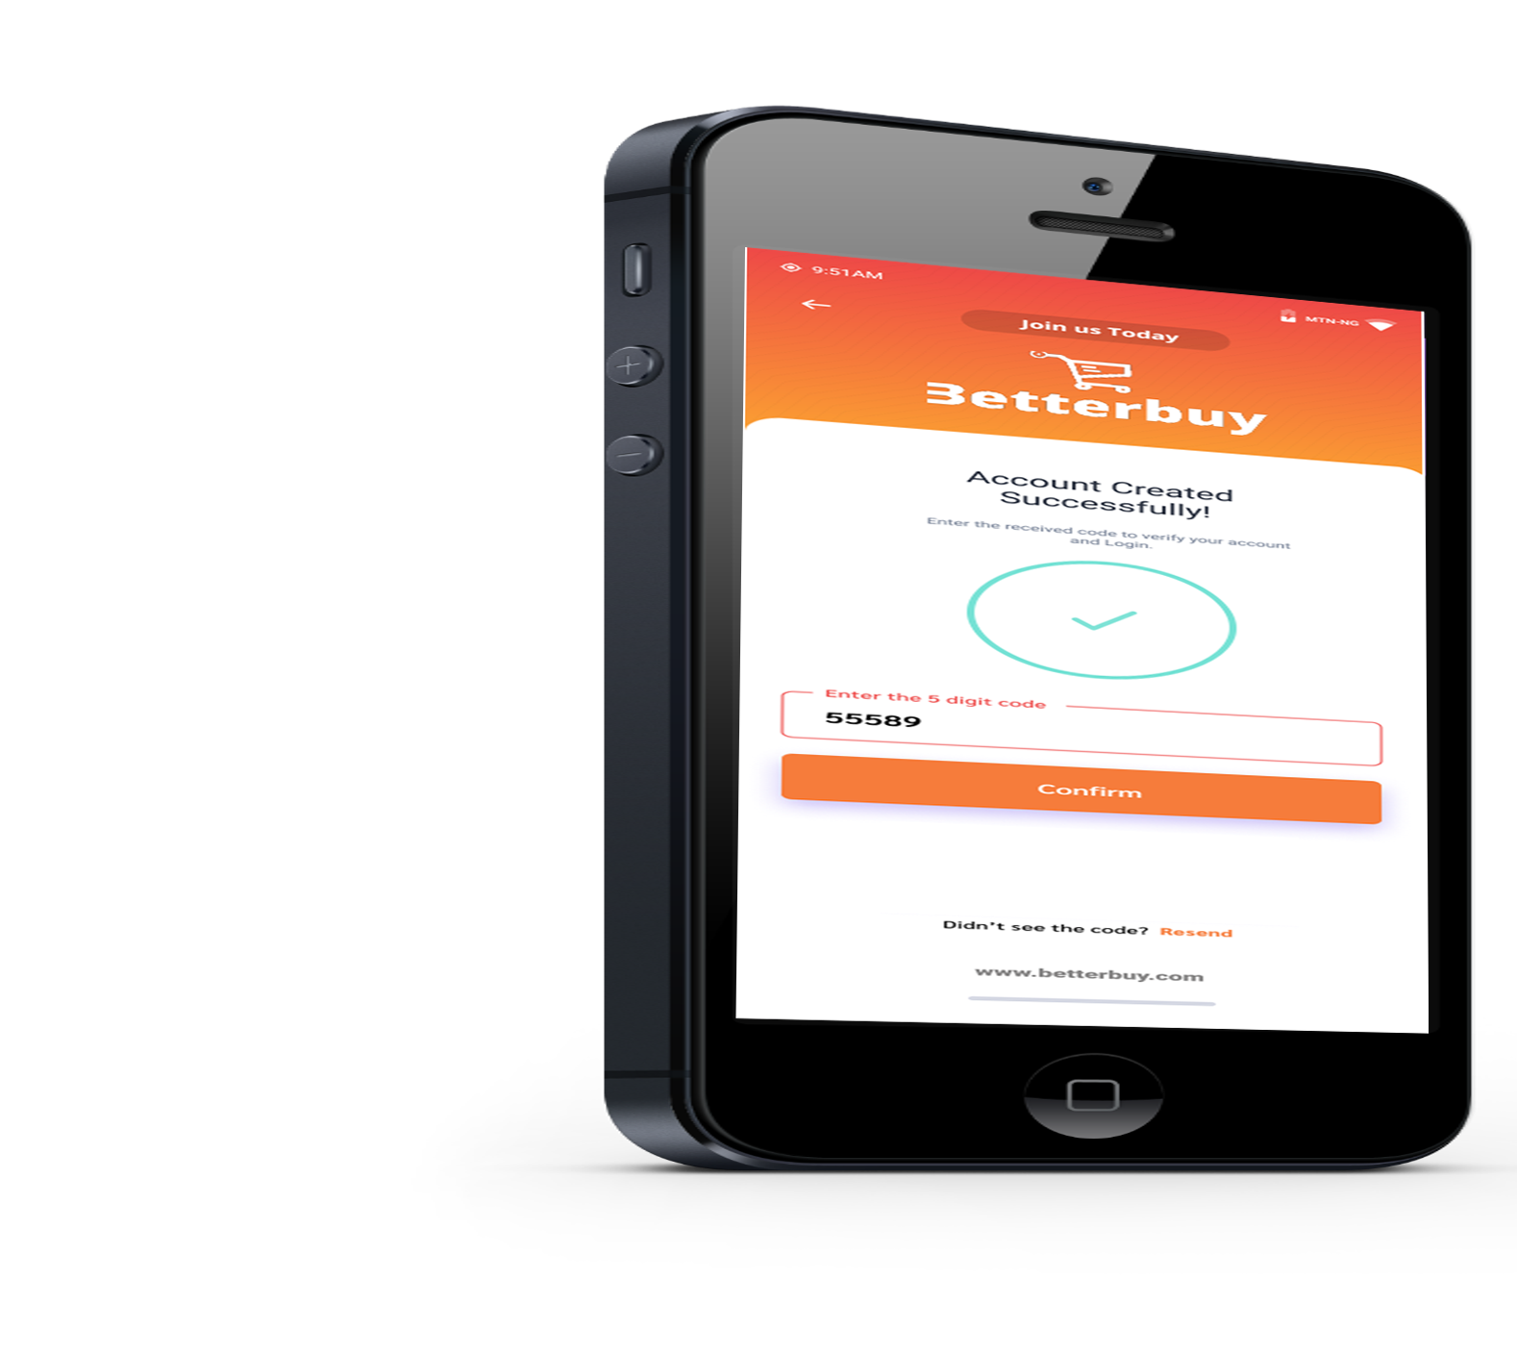

Betterbuy Mobile App
Suitable for all mobile devices, from iOS to Android
Email Address
Location Address
info@betterbuy.com
www.betterbuy.com
59C Edo Innovation Hub
Benin City
Betterbuy.com is an e-commerce start-up company positioning itself to become the market leader in offering online merchants and consumers a uniform and trouble-free way to return merchandise purchased online.

Available in the

Available in the
Google Play
App Store

Slide 6

THANK YOU.
Contact us.
Internet Connections
www.betterbuy.com
info@betterbuy.com
Phone Numbers:
Tel : +234 8165477706
: +234 8124946674
/betterbuy
/betterbuy
e-Commerce Store
/betterbuy
/betterbuy
SHOP NOW
www.betterbuy.com

